Slide 1
Database Management System Project ON Hotel Management System

Slide 2
Group 7 – Batch 2
Ravi Limbad 1401077
Falgun Prajapati 1401080
Kunal Suba 1401097
Shloak Agarwal 1401105
Course Instructor: Prof. P M Jat
Mentored by: Purnima Shah

Slide 3
Problem Definition
The topic is Hotel Management System. So, this project would basically have many features from the perspective of the Hotel Staff as well as customers. A hotel is a hive of numerous operations such as front office, booking and reservation, security, housekeeping and more. Hotel has a number of rooms and these rooms are of different categories. On the basis of room category, each room has different price. Hotel has a number of employees to manage the services provided to customers. Customer record is stored in hotel database which contains customer identity, his address, check in time, check out time etc. Hotel provides food and beverages to their customers and generates the bill for this at the time of their check out.

Slide 4
Problem Definition
We can have various number of tables like Rooms, Staff, Food Items, Beverages, Customer Details, Stay Details, Reservation, etc. What type of questions/queries will be solved with this project?
To see which guests are coming today
To see which guests are leaving today
To calculate the total bill of the guests including the beverages and food facilities used by them
To see the staff allotment in various departments
To see which rooms are available for new guests
To see which room falls under what category
To check about the party orders if any in the banquet
To receive the feedback of guests
All of these queries/questions will be solved in our project

Slide 5
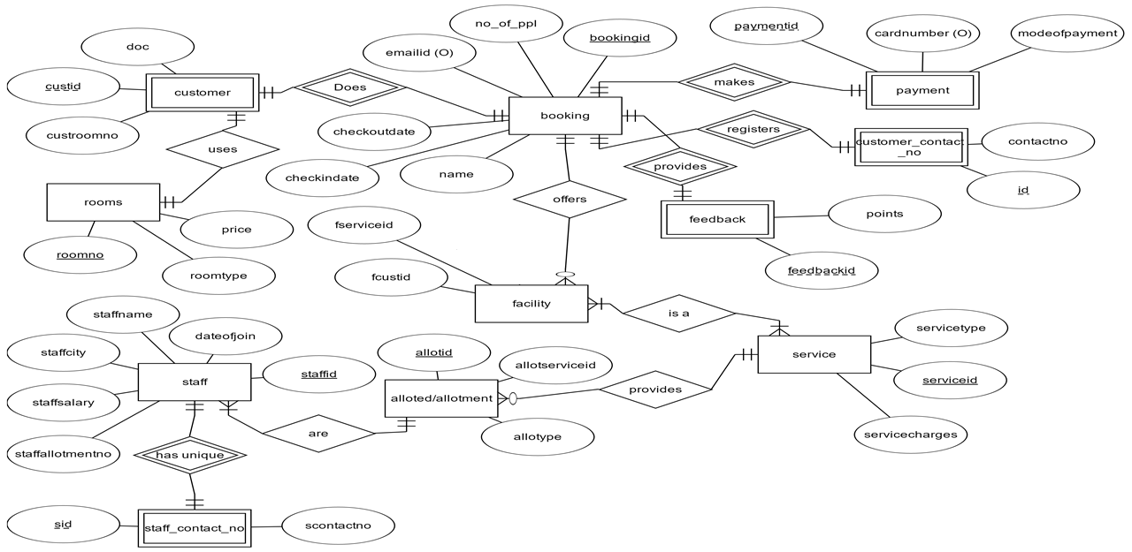
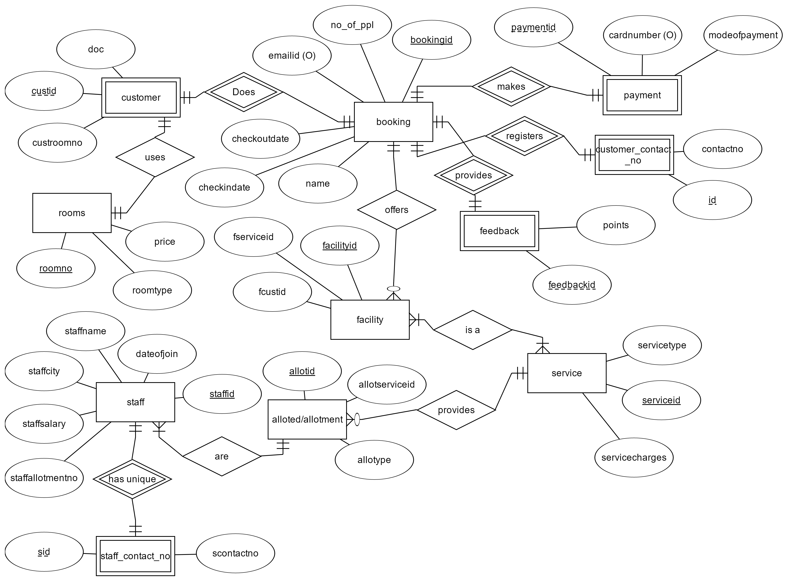
Entity Relationship diagram(erd)

Slide 6
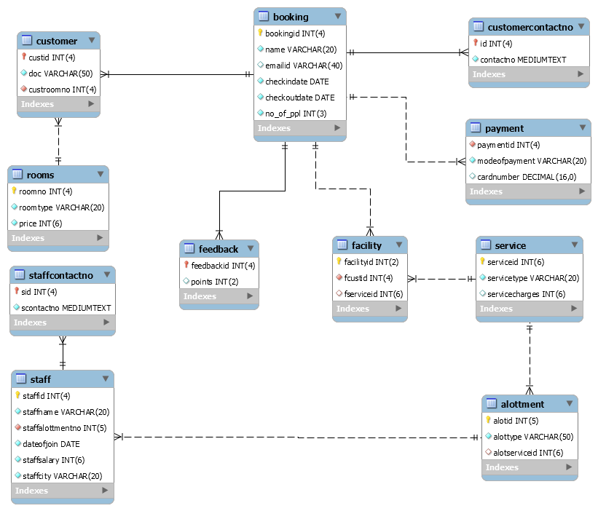
Enhanced Entity Relationship diagram (eerd)

Slide 7
Functional dependencies
1. booking table:-
bookingid -> { name,
emailid,
checkindate,
checkoutdate,
no_of_ppl }
2. customer table:-
custid -> { doc,
custroomno }

Slide 8
Functional dependencies
3. customer_contact_no_table:-
id -> { contactno }
4. rooms table:-
roomno -> { roomtype,
price }
5. service table:-
serviceid -> { servicetype,
servicecharge }

Slide 9
Functional dependencies
6. staff table:-
staffid -> { staffname,
staffallotmentno,
dateofjoin,
staffsalary,
staffcity }
7. Staffcontactno table :-
sid -> { scontactno }
8. feedback table:-
feedbackid -> { points }

Slide 10
Functional dependencies
9. alottment table:-
alotid -> { alottype,
alotserviceid }
10. payment table:-
paymentid -> { modeofpayment,
cardnumber }
11. facility table:-
facilityid -> { fcustid,
fserviceid }

Slide 11
Complex Queries
Query and screenshots

Slide 12
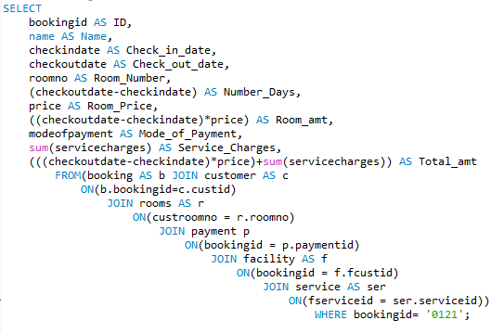
1. Generating Bill:

Slide 13
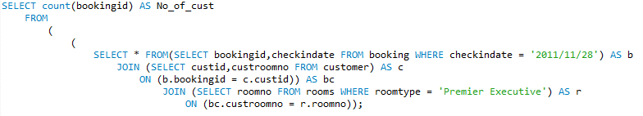

2.Count the number of customers checked in to Premier Executive rooms on 2011/11/28?

Slide 14
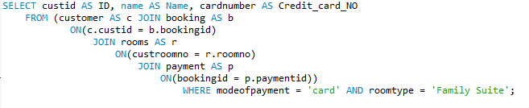

3.List id, name and card number of customers who checked in to Family Suite room and mode of payment was card?

Slide 15

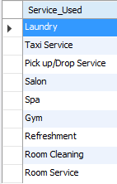
4. List the number of facilities used by customers.

Slide 16
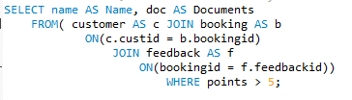
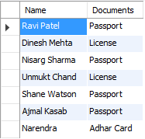
5. List the name, document submitted by the customer who gave feedback points > 5 ?

Slide 17
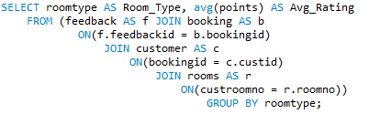
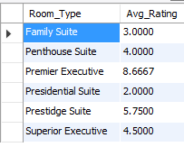
6. Count the average feedback points for each room type :-

Slide 18
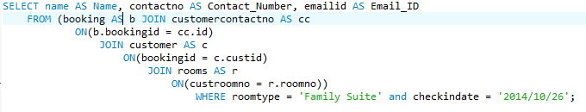

7. Show name, contactno, emailid of customers who booked Family Suite and checked in on 25/12/2015

Slide 19
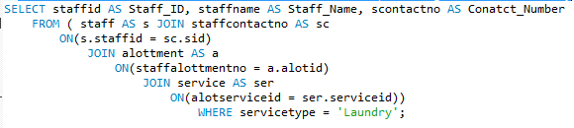
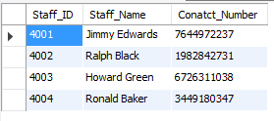
8. List contact number, name and id of staff who are providing service as laundry
Answer:

Slide 20


9. Count the number of staff members whose salary is less than 10000 and allotted to Gym

Slide 21


10. Count the number of staff employees providing service in saloon and are from Delhi

Slide 22
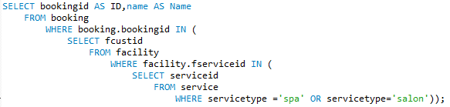
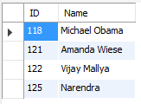
11. Find name and id of customers who have used service of spa or Salon?

Slide 23
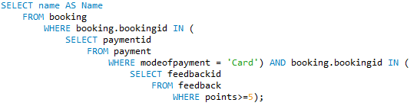

12. Find the names of customers who have paid through card and given feedback above 5?

Slide 24
Triggers and screenshots

Slide 25





Trigger 1
When a customer leaves the hotel all his record gets deleted so after deleting in booking table, customer record in customer table, facility table, feedback table, customercontactno table gets deleted.
Tables before trigger gets fired
Booking Table
Customercontactno Table
Facility Table
Feedback Table
Customer Table

Slide 26
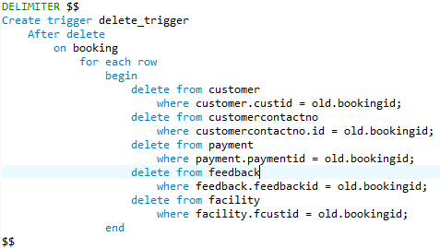
Trigger Statement
When below statement gets executed

Slide 27




After trigger get executed
Booking Table
Customer Table
Customercontactno Table
Facility Table
Feedback Table

Slide 28


Trigger 2
When a staff member leaves the job, his/her contact number is deleted from staffcontactno and all other details from staff.
Tables before trigger gets fired
Staff Table
Staffcontactno Table

Slide 29

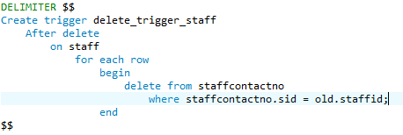
When below statement gets executed

Slide 30


Staff Table
Staffcontactno Table

Slide 31

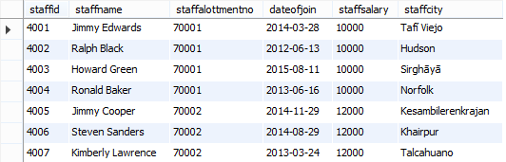
Trigger 3
When alotid is deleted from alottment table the staffalottmentno gets updated.
Tables before trigger gets fired
Alottment Table
Staff Table

Slide 32
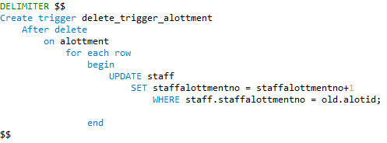
When below statement gets executed

Slide 33

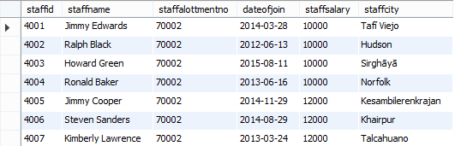
Alottment Table
Staff Table

Slide 34



Trigger 4
When serviceid is deleted from service table the alotseviceid gets update and all facility belonging to it gets deleted.
Tables before trigger gets fired
Facility table
Service table
Alottment table

Slide 35
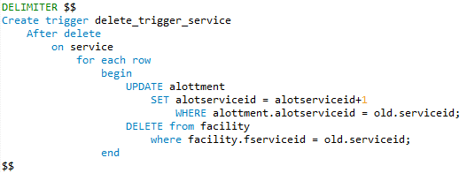
When below statement gets executed

Slide 36



Service table
Facility table
Alottment table

Slide 37
Thank you

